Slide 1
Module 5: Sampling
5.14: Differential Privacy
Annie Collins
Data Sciences Institute, University of Toronto

Slide 2
Key Texts
Salganik, M. (2019). Understanding and managing informational risk. In Bit by bit: Social research in the Digital age (pp. 307–314). Chapter, Princeton University Press.
Wood, A., Altman, M., Bembenek, A., Bun, M., Gaboardi, M., Honaker, J., Nissim, K., OBrien, D.R., Steinke, T., & Vadhan, S. (2018). Differential privacy: A primer for a non-technical audience. Vanderbilt Journal of Entertainment & Technology Law, 21(1) 209-275.

Slide 3
Background

Slide 4
Informational Risk and Anonymization
Informational risk refers to the potential for harm to occur from the disclosure and sharing of data
Anonymization refers to the process of removing personally identifying information (PII) from a data set in hopes of keeping the data anonymous upon release to a broader audience (other researchers, the general public, etc.)
Anonymization is often not entirely effective at keeping data anonymous

Slide 5
Case Study: Massachusetts Group Insurance Company
The GIC is a government agency responsible for purchasing insurance and managing health records for Massachusetts state employees. They released an “anonymized” data set of health records that excluded names and addresses but included zip code, birthdate, sex, and medical information.
Latanya Sweeney obtained this data set and a copy of voting records for the city of Cambridge, MA, which included name, zip code, birthday, and sex. By linking records between the two data sets, Sweeney was able to find extract then governor William Weld’s medical records.

Slide 6
Case Study: The Netflix Prize
In 2006, Netflix released a data set of 100 million movie ratings from almost 500,000 users as part of a contest to improve its movie recommendation algorithm. The data had PII removed and slight perturbations introduced in some ratings. Similar to the GIC example, researchers Arvind Narayanan and Vitaly Shmatikov combined the Netflix data with user data from IMDb to identify individuals who left particular movie ratings in the Netflix data.
This re-identification process resulted in a lawsuit filed against Netflix citing potential harms as a result of personal information uncovered in the data linkage. Movie ratings and reviews from the data sets had potential to expose users sexuality, political views, experience with mental illness and substance abuse, and more.
Notes:
Additional information on lawsuit: https://www.wired.com/2009/12/netflix-privacy-lawsuit/

Slide 7
Differential Privacy

Slide 8
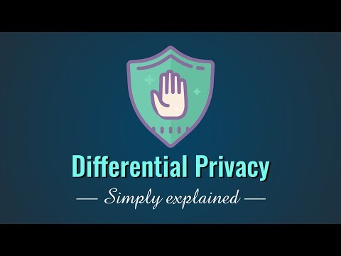
Introduction to Differential Privacy by Simply Explained

Slide 9
Differential Privacy
The goal of differential privacy is to analyze and share information about a data set without revealing information about any given individual within the data set
Differential privacy techniques add random noise to computations on the data set
Randomness obscures any one individual’s contribution to the data set
Randomness means that all output is approximate
Generally used for aggregate statistics and modelling – counts, proportions, averages, linear regression, machine learning algorithms

Slide 10
Based on Nissim et al., Figure 2
Input
Traditional Analysis
Analysis/
Computation
Output
Random Noise
Input
Output
Differential Privacy Approach
Analysis/
Computation

Slide 11
“Opt-out” Scenarios
Suppose John is invited to participate in a study about the relationship between socioeconomic factors and medical outcomes in the US. Participants are asked to complete a questionnaire covering topics related to their finances and medical history. John is concerned that information he provides, such as his HIV status, may be used against him if de-identified data is released and accessed by his insurance company. However, he recognizes that participating in the study would benefit the researchers and perhaps generate important results.

Slide 12
“Opt-out” Scenarios
John’s opt-out scenario refers to the case where John decides not to participate and the analysis is conducted without his health or financial data
Differential privacy ensures that:
Results of the study will stay approximately the same regardless of whether or not John participates
Output of the analysis will not disclose any information that is specific to John
Thus, John faces minimal additional informational risk by participating in the study

Slide 13
Privacy Loss Parameter

Slide 14
Privacy Loss Parameter
Estimates from a data set should remain approximately the same regardless of any one individuals’ data being included or excluded
Differential privacy allows a slight difference between actual analysis and any individual opt-out scenario
Privacy loss parameter, 𝝐, represents the additional informational risk that any individual would face beyond the risk incurred in the opt-out scenario
0 ≤ 𝝐 ≤ 1
Low 𝝐 = Low accuracy, stronger privacy protection
High 𝝐 = High accuracy, weaker privacy protection

Slide 15
Based on Nissim et al., Figure 3
Random Noise
Input
Output
“Real world” scenario
Analysis/
Computation
Difference of at most 𝝐%
Random Noise
Input without Individual X’s data
Individual X’s opt-out scenario
Output
Analysis/
Computation

Slide 16
From Nissim et al., pp. 12
John is concerned that a potential health insurance provider will deny him coverage in the future, if it learns certain information about his health, such as his HIV positive status, from a medical research database that health insurance providers can access via a differentially private mechanism.
If John believes his probability of being denied insurance coverage is at most 5% (due to various outside factors) if his information is not included in the medical research database, then adding his information to the database can increase this probability to, at most,
5% · (1 + 𝝐) = 5% · 1.01 = 5.05%.
Hence, the privacy loss parameter (𝝐 = 0.01, in this example) ensures that the probability that John is denied insurance coverage is almost the same, whether or not information about him appears in this medical research database.
Notes:
Ask students to consider how this would be different if 𝝐 = 0.1.

Slide 17
Implementation

Slide 18
Overview
Differential privacy adds uncertainty to data in the form of random noise
Suppose you are looking to measure the fraction p of some trait in a population. You have a sample of size n, and within this sample there are m individuals with the trait.
Without differential privacy, p = m/n.
With differential privacy, random noise Y is added to the computation to hide the contribution of a single individual.
Instead of m, we have m’ = m + Y.
Instead of p = m/n, we have p’ = m’/n = (m + Y)/n.

Slide 19
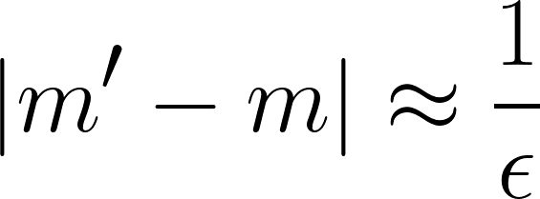
Random Noise
Magnitude of the random noise Y depends on 𝝐
𝝐 and Y are inversely proportional – smaller 𝝐 = larger Y = more noise
The relationship between the true and measured values of m can be described as,
Y is often sampled from the Laplace distribution with mean 0 and standard deviation √2/𝝐
Denoted Laplace(0, 1/𝝐)

Slide 20
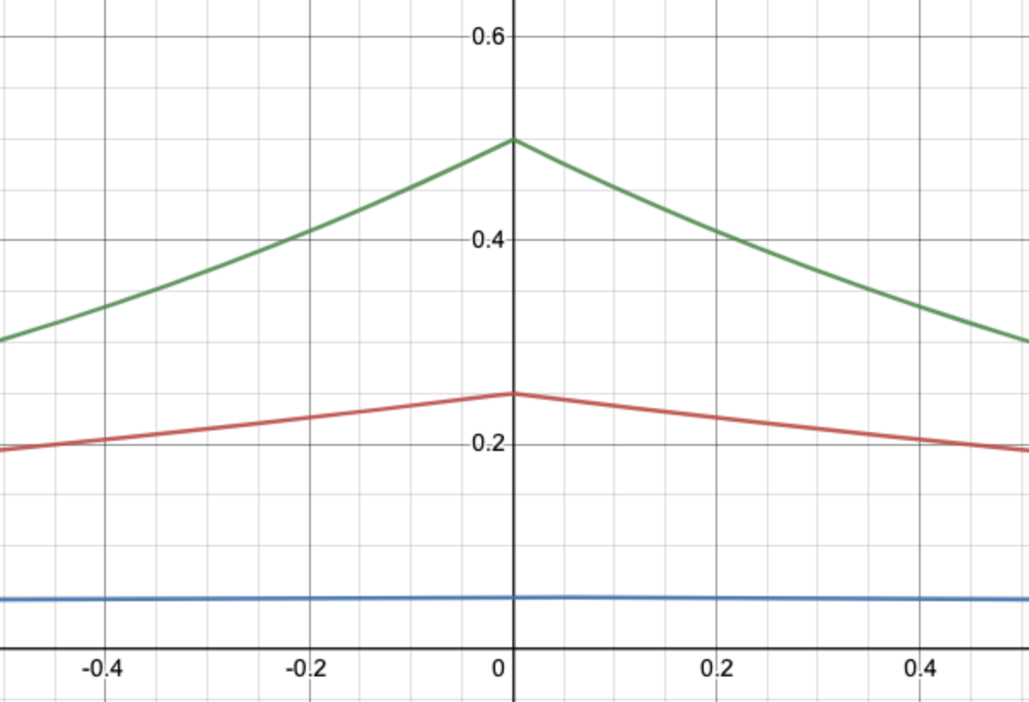
Laplace Distribution
Distribution is symmetric – differential privacy estimates are equally likely to be higher or lower than the true value
When 𝝐 = 1, there is a ~63% chance that -1 ≤ Y ≤ 1
m’ will likely be very close to m
High accuracy, low privacy
When 𝝐 = 0.1, there is a ~10% chance that -1 ≤ Y ≤ 1
m’ will likely not be very close to m
Low accuracy, high privacy
𝝐 = 1
Probability of being sampled
𝝐 = 0.5
𝝐 = 0.1
Value of Y

Slide 21
Practical Considerations

Slide 22
Practical Considerations
Accuracy
Large sample sizes/data sets are required for accurate estimates
Informational risk
Combining differentially private data sets or conducting multiple queries on the same differentially private data set increases informational risk
Total informational risk is bounded by the sum of the informational risk of any individual data set
For a combination of n differentially private data sets, 𝝐_{T} = 𝝐₁ + 𝝐₂ + … + 𝝐_{n}
Different types of analyses will require different balances of informational risk and accuracy

Slide 23
Ethical Considerations

Slide 24
Ethical Considerations
Data sensitivity
Sensitivity is subjective
Assume that all data is potentially identifiable and potentially sensitive
Privacy concerns apply to all data sets to some degree
Data sharing
Data sharing increases informational risk
Access to data provides great benefit to other researchers and the general public
Do not ignore the potential benefits of data sharing

Slide 25
Based on Salganik (2018), Figure 6.6
Differential privacy
Release to public with no/limited anonymization
Benefit to society
No data sharing
Risk to participants

Slide 26
Next
5.15 Ethics

